Slide 1


ArchiMate Modeling using Archi® Tool
00
Opening and Introduction
Based on Sparx Systems’ ArchiMate Introduction

Slide 2
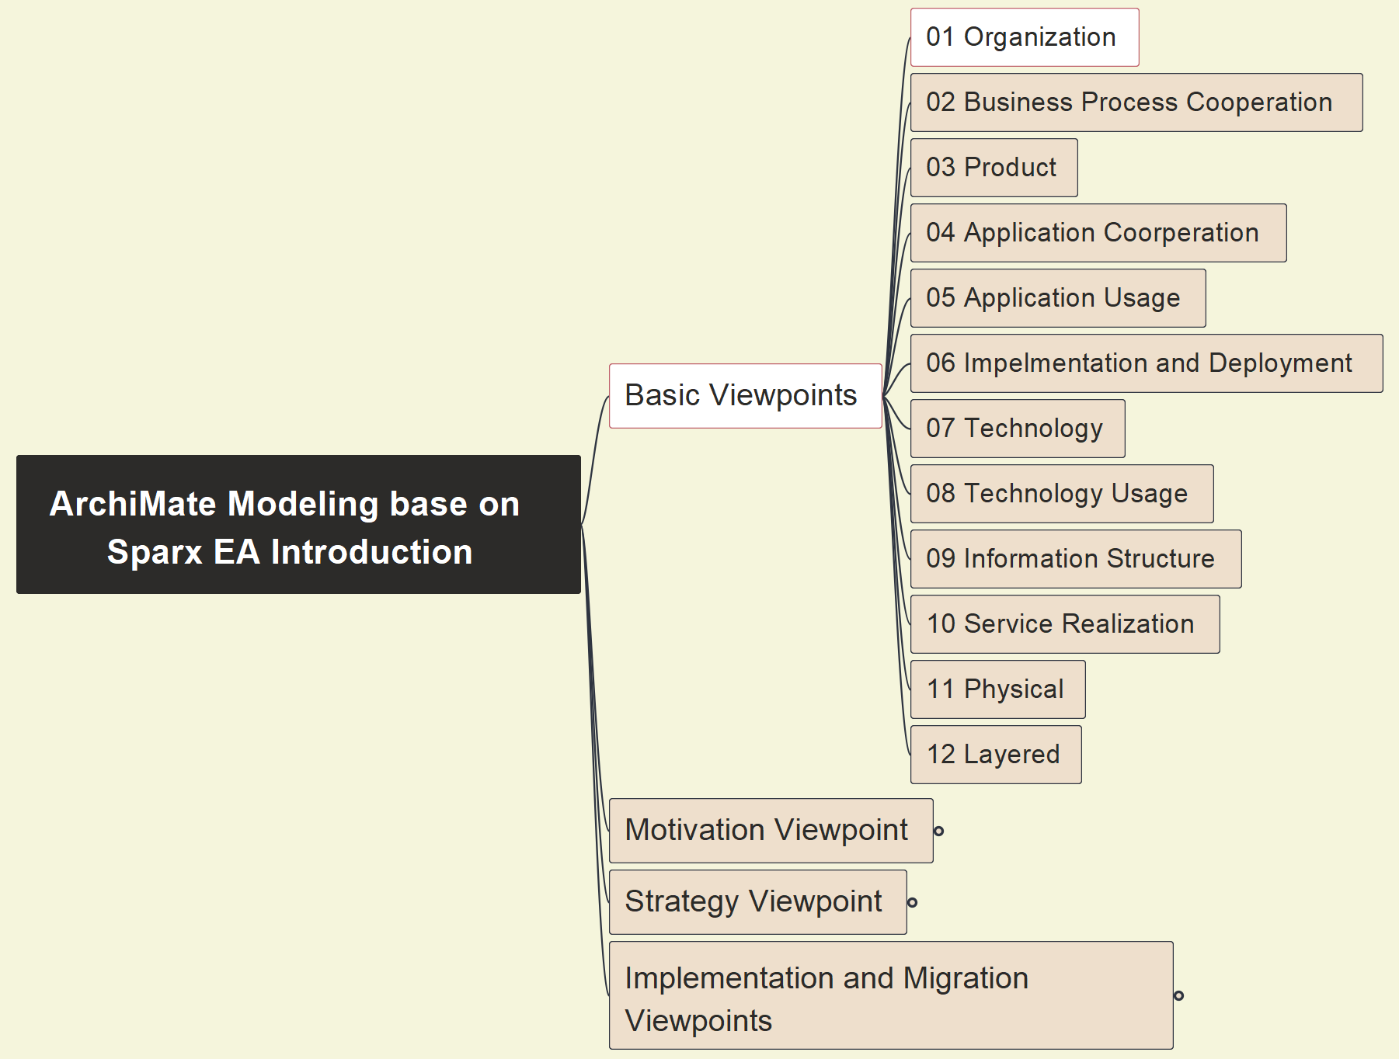
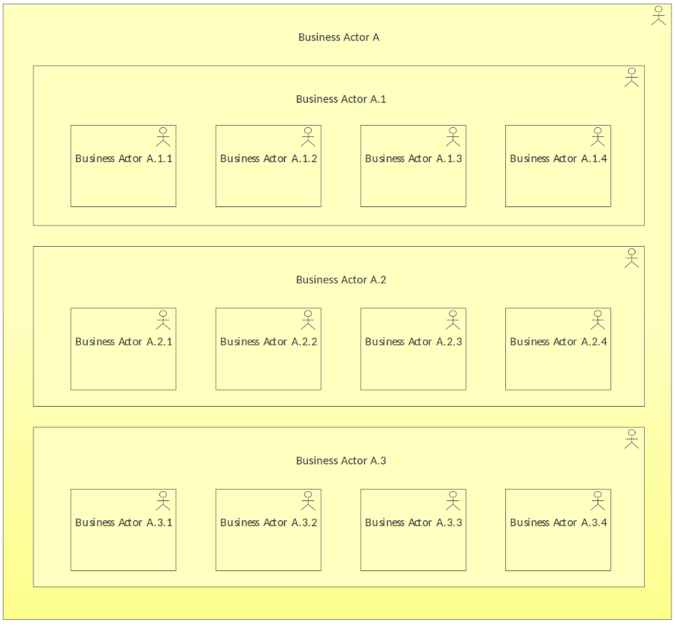
01 Organization
01

